Slide 1
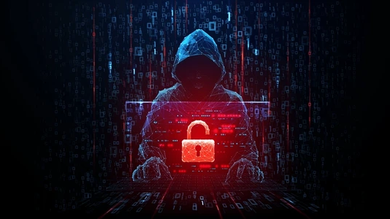
CYBERSECURITY TRAINING
PHISHING
AWARENESS
Recognize, Understand, and Protect Yourself from Cyber Threats
DON'T TAKE THE BAIT

Slide 2
OVERVIEW
What We'll Cover
01
02
03
Understanding Phishing
Recognizing the Threats
Social Engineering Tactics
The anatomy of a digital deception and the scale of the threat
Spot red flags in emails and fake websites before you click
How attackers hack your mind, not your software
04
05
Real-World Examples
Protection & Best Practices
Lessons from major breaches across industries
Build your personal defense system and know how to respond
02

Slide 3
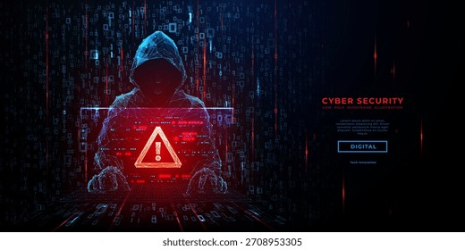
01
CHAPTER ONE
UNDERSTANDING PHISHING
The anatomy of a digital deception

Slide 4
What Is Phishing?
Phishing is a cyberattack where attackers impersonate trusted entities to steal sensitive information like passwords, credit cards, or personal data.
It remains the #1 global cyberattack vector. Attackers use emails, fake websites, SMS (smishing), voice calls (vishing), and social media to deceive victims.
The goal is simple: trick you into clicking a malicious link, opening an infected attachment, or sharing confidential information.
1.13M+
phishing attacks per quarter in 2025
37%
of global breaches begin with phishing
Source: ESED Phishing Report 2024-2025
ATTACK CHANNELS
Email Phishing
Smishing
Vishing
Fake Websites
Social Media
04

Slide 5
The Evolution of Phishing Attacks
Phishing is no longer just poorly written emails. In 2025, attacks have become more sophisticated, leveraging AI and new channels to bypass defenses.
AI-Generated Phishing
MFA Bypass Attacks
Smishing & Vishing
AI-generated content increased 22% year-over-year, creating more realistic and polished scam messages.
15% of credential theft attacks now incorporate mechanisms resistant to multi-factor authentication.
19% of breaches now come from SMS and voice-based attacks, beyond traditional email.
Deepfakes & Voice Cloning
Phishing-as-a-Service
AI-generated video and voice deepfakes are emerging as powerful tools for executive impersonation and fraud.
Criminals now rent phishing toolkits. Investment scams like "Nomani" rose 62% with 64,000+ malicious URLs blocked.
Source: ESED Phishing Report 2024-2025
05

Slide 6
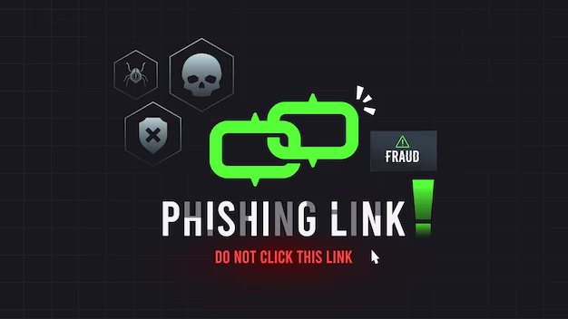
02
CHAPTER TWO
RECOGNIZING THE THREATS
Spot the red flags before you click

Slide 7
Top 10 Red Flags in Phishing Emails
1. Suspicious sender address — misspelled domains, unfamiliar senders, or generic webmail addresses
2. Urgent or threatening language — "Account suspended," "Final warning," "Immediate action required"
3. Generic greetings — "Dear Customer" instead of your name
4. Poor grammar and spelling — awkward phrasing, machine-translated feel
5. Requests for sensitive info — passwords, MFA codes, credit card numbers
6. Mismatched URLs — hover to reveal the true destination before clicking
7. Unexpected attachments — especially .iso, .js, .scr, or .html files
8. Fake branding — low-res logos, wrong colors, inconsistent design
9. Too-good-to-be-true offers — unexpected prizes, awards, or jobs
10. Odd timing or context — emails sent at unusual hours or unrelated to your work
Pro Tip: Scammers intentionally use poor grammar to filter out attentive targets. Don't be an "easy mark."
07

Slide 8
How to Spot Fake Websites
Fake websites are designed to look identical to legitimate ones. Here's how to verify before you enter any credentials:
Verify the Domain Name
HTTPS Padlock != Safe
Look for misspellings like micr0soft.com or extra characters in the URL.
20% of phishing sites now use HTTPS. Trust the domain, not the padlock.
Check for Poor Design
Browser-in-the-Browser Attacks
Low-res logos, broken links, missing pages, or inconsistent branding are warning signs.
Fake login pop-ups that can't be moved or detached from the browser window.
THE GOLDEN RULE
Always navigate to websites manually from your bookmarks or by typing the URL directly. Never use links from unsolicited emails, texts, or messages.
08

Slide 9
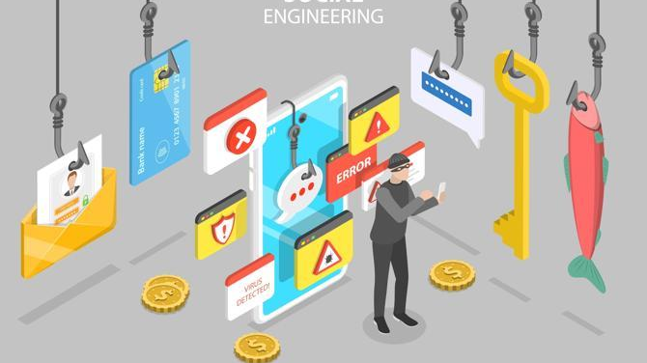
03
CHAPTER THREE
SOCIAL ENGINEERING TACTICS
How attackers hack your mind, not your software

Slide 10
Common Social Engineering Techniques
Email Phishing
Spear Phishing
Whaling
Mass scam emails impersonating trusted entities to lure clicks on malicious links or attachments.
Targeted attacks customized for specific victims, often using personal details found online.
Targeting C-suite executives for high-value gains, often through Business Email Compromise (BEC).
Smishing & Vishing
Pretexting
QR Code Phishing
SMS and voice-based attacks. 19% of breaches now come from these channels beyond email.
Creating believable scenarios to build false trust, impersonating vendors, bosses, or officials.
Malicious QR codes (quishing) leading to fake login or payment pages.
EMERGING THREATS
Deepfake Fraud: AI-generated voice and video impersonation during live calls. Baiting: False promises exploiting curiosity or greed. Scareware: False malware alarms prompting dangerous software installs.
10

Slide 11
The Psychology Behind Social Engineering
Attackers don't hack computers—they hack people. They exploit psychological triggers to bypass your critical thinking.
Authority
Urgency
Fear
Posing as executives, IT support, or officials to demand compliance.
Creating time pressure to bypass careful analysis. "Act now or lose access."
Threatening account suspension, security breaches, or legal consequences.
Curiosity
Trust
Reciprocity
Enticing clicks with provocative subjects, mysterious attachments, or "you won't believe this" hooks.
Impersonating colleagues, friends, or known brands to lower defenses.
Offering fake rewards, assistance, or exclusive deals to create obligation.
11

Slide 12
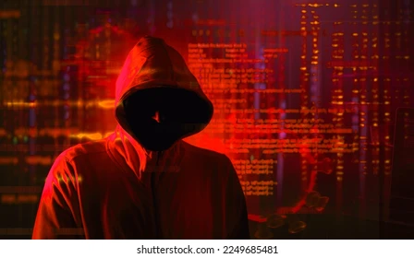
04
CHAPTER FOUR
REAL-WORLD EXAMPLES
Lessons from major breaches

Slide 13
Famous Phishing Cases & Their Impact
MGM Resorts International (2023)
Hospital Sisters Health System (2023)
Voice phishing by the "Scattered Spider" group disrupted casino and hotel operations nationwide. Attackers used social engineering to bypass identity verification.
882,000 patients were notified of a data breach exposing names, birthdates, SSNs, medical records, and insurance details.
Grubhub (2025)
Casio UK (2025)
A compromised third-party service provider exposed customer, driver, and merchant data—including partial payment card information.
E-shop hacked with malicious scripts stealing credit card and customer details over a 10-day period. Part of a larger campaign hitting 17+ e-commerce sites.
Finastra (2024)
A British fintech firm suffered unauthorized access to its Secure File Transfer Platform, compromising sensitive customer information.
Key Insight: Phishing targets every industry—from hospitality to healthcare to finance. No organization is immune.
Source: PowerDMARC Phishing Examples
13

Slide 14
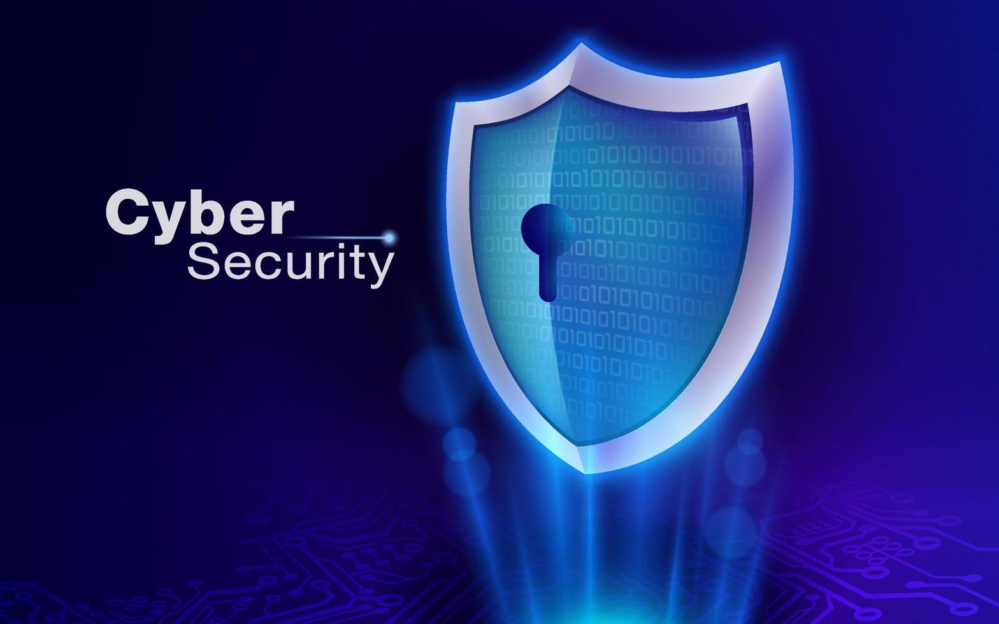
05
CHAPTER FIVE
PROTECTION & BEST PRACTICES
Build your personal defense system

Slide 15
Best Practices to Avoid Phishing
PERSONAL HABITS
ORGANIZATIONAL MEASURES
1. Slow down — phishing depends on creating urgency
2. Never click unexpected links or open attachments
3. Hover over links to verify the actual URL destination
4. Verify sender identity through a separate channel
5. Use unique, strong passwords for every account
6. Enable MFA on all accounts (avoid SMS-based MFA)
7. Keep software updated with latest security patches
8. Reduce personal info shared publicly online
1. Deploy anti-phishing technology and DMARC policies
2. Conduct regular phishing simulations and training
3. Establish clear reporting protocols for suspicious emails
4. Apply software updates and patches promptly
5. Block known malicious IPs, domains, and file types
6. Use multi-factor authentication on all systems
7. Maintain regular data backups offline
8. Update incident response plans for phishing events
Sources: Canadian Centre for Cyber Security, Microsoft Security
15

Slide 16
What to Do If You Fall Victim
If you suspect you've been phished, act immediately. Every minute counts in limiting the damage.
1
Document Everything
4
Notify IT / Security Team
Write down what you clicked and what information you shared while it's fresh.
Alert your organization's security team immediately if work accounts are affected.
2
Change Passwords Immediately
5
Contact Financial Institutions
Update passwords on all affected accounts and anywhere you reused them.
Alert banks and credit card companies if financial data was compromised.
3
Enable or Verify MFA
6
Report to Authorities
Turn on multi-factor authentication on every account possible.
Report identity theft or financial loss to local law enforcement.
Additional Steps
Run a full security scan. Disconnect from the network if malware is suspected. Monitor all accounts closely for unauthorized activity.
16

Slide 17
Quick Quiz: Can You Spot the Phish?
SCENARIO 1
SCENARIO 2
SCENARIO 3
You get an email from security@amaz0n-support.com saying your account will be suspended in 24 hours.
A LinkedIn message from a recruiter asks you to download a file to "view job details."
Your "CEO" emails you at 2 AM asking for urgent gift card purchases.
A. Click the link and log in immediately
A. Download and open the file
A. Buy the gift cards immediately
B. Check domain, ignore urgency, log in via amazon.com
B. Verify profile and ask for details via official channels
B. Verify via separate channel and follow protocols
ANSWERS
Scenario 1 — B is correct. The domain "amaz0n-support.com" is misspelled. Always log in directly via the official website, never through email links.
Scenario 2 — B is correct. Unexpected file downloads are a major malware vector. Verify the recruiter's legitimacy through official channels first.
Scenario 3 — B is correct. This is a classic whaling/BEC attack. CEOs don't request gift cards at 2 AM. Always verify unusual financial requests.
17

Slide 18
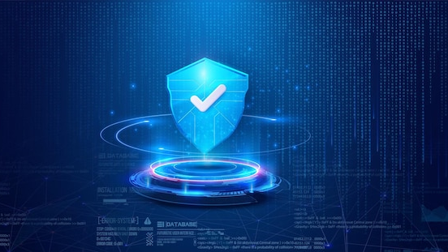
REMEMBER
STAY ALERT.
STAY SAFE.
When in doubt, don't click.
Verify independently.
Report suspicious messages.
Cybersecurity is a shared responsibility.
THANK YOU

